Slide 1
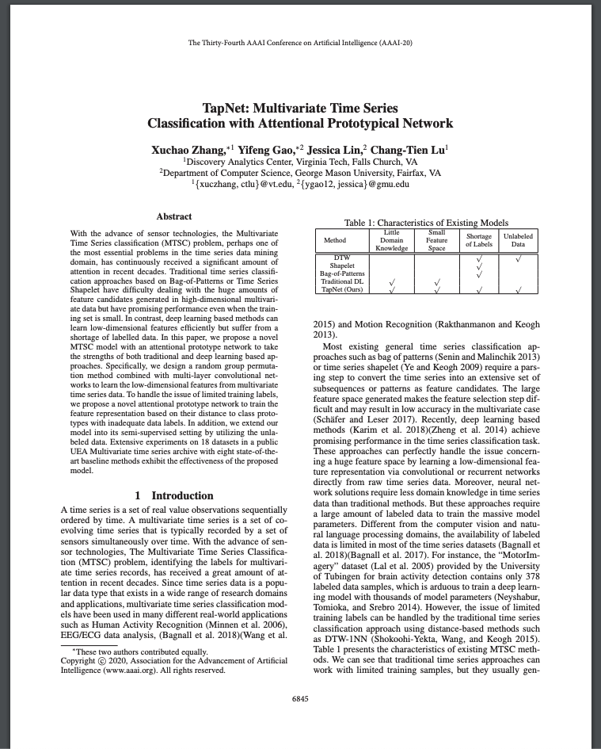
TapNet: Multivariate Time Series Classification with Attentional Prototypical Network
By Xuchao Zhang, Yifeng Gao, Jessica Lin, Chang-Tien Lu
Presented by Herman Rommetveit
Norwegian University of Science and Technology
1

Slide 2
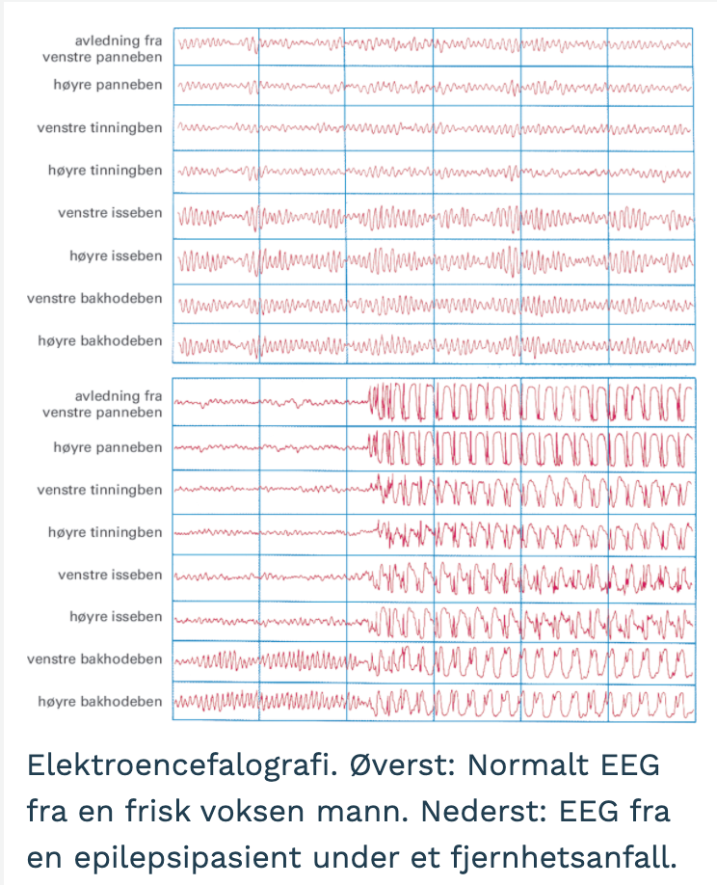
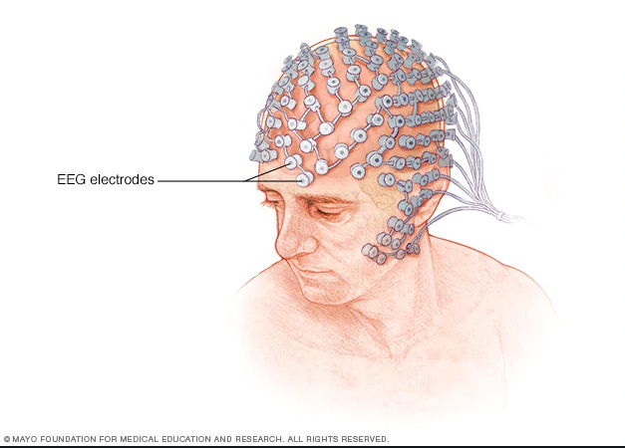
Motivation
Advance of sensor technologies
Real world applications
Electroencephalography (EEG)
Electrocardiography (ECG)
Human Activity Recognition (HAR)
Human Motion Recognition (HMR)
Limited labeled data

Slide 3
Problem Description
The multivariate time series classification (MTSC) problem
training a classifier f to predict a class label y for a multivariate time series where the label is unknown
The semi-supervised multivariate time series classification (SMTSC) problem
training a classifier f to predict a class label y for a multivariate time series for which the label is unknown, with the help of both labeled and unlabeled data

Slide 4
Related Work
Supervised MTSC
Semi-Supervised MTSC
Traditional time series classification models
Ultra Fast Shapelets (UFS)
Generalized Random Shapelet Forests (gRSF)
WEASEL-MUSE (bag-of-patterns)
Deep learning based classification models
Multi Channel Deep Convolutional Neural Network (MCDCNN)
Multivariate LSTM-FCN (MLSTM-FCN)
DTW (Dynamic Time Warping)
SUCCESS (hierarchical clustering and DTW)
Most work on semi-supervised time series classification focuses on univariate time series

Slide 5
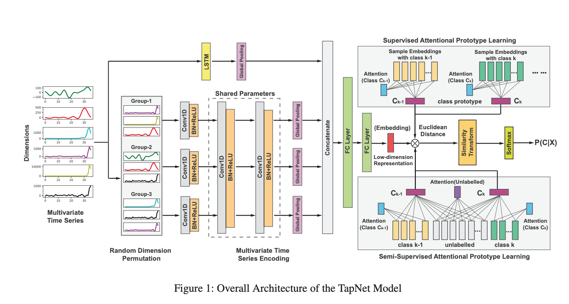
Methods
TapNet Model Architecture Overview
Three main components
Random Dimension Permutation
Multivariate Time Series Encoding
Attentional Prototypical Network

Slide 6
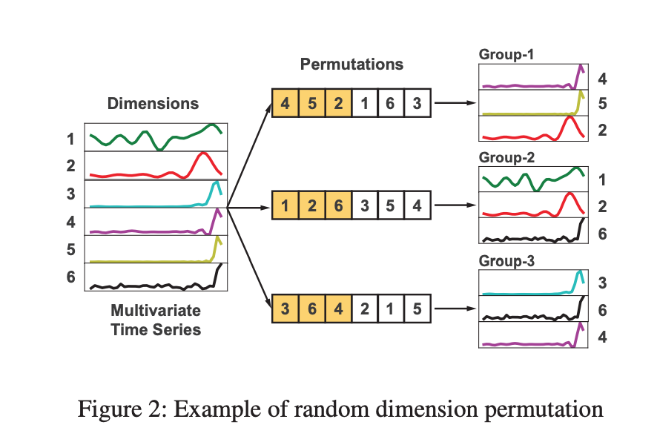
Methods
1. Random Dimension Permutation
Reorganize the dimensions into groups based on random permutations of orders
Capture the interactive features between multivariate dimensions

Slide 7
Methods
2. Multivariate time series encoding
Learn a low-dimensional embedding for each multivariate time series
LSTMs extract the sequential temporal information
CNNs model the dependencies between the grouped time series dimensions
The results of all the groups of convolutional networks and the LSTM are concatenated

Slide 8
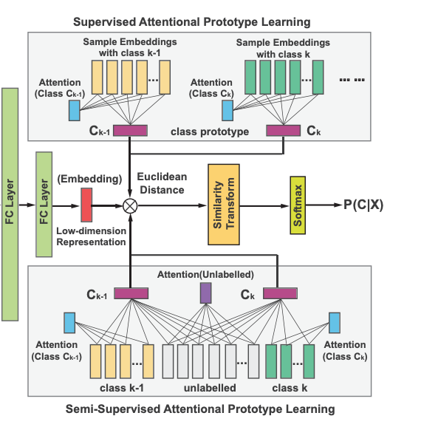



Methods
3. Supervised Attentional Prototypical Network
Learn a prototype embedding, C_{k}, for each class represented in the dataset
Bag of time series embeddings H_{k} all belonging to the class k
Each class prototype is represented by a weighted sum
.
A_{k} weights for the class k is computed by

Slide 9



Methods
3. Semi-supervised Attentional Prototypical Network
Utilize the unlabeled data samples to get better prototype embeddings for the classes
Bag of time series embeddings of the unlabeled data samples
Prototypes are calculated by combining the weighted sums of both the labeled and unlabeled data samples
The weights for the unlabeled datasamples is computed by

Slide 10
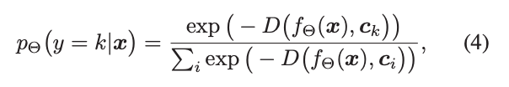
Methods
How the network is trained
Given a class prototype C_{k} and an embedding of a time series x, we can calculate the probability that the time series is of class k by
The training of the model is done by minimizing the negative log probability of the true class of x (Adam)

Slide 11
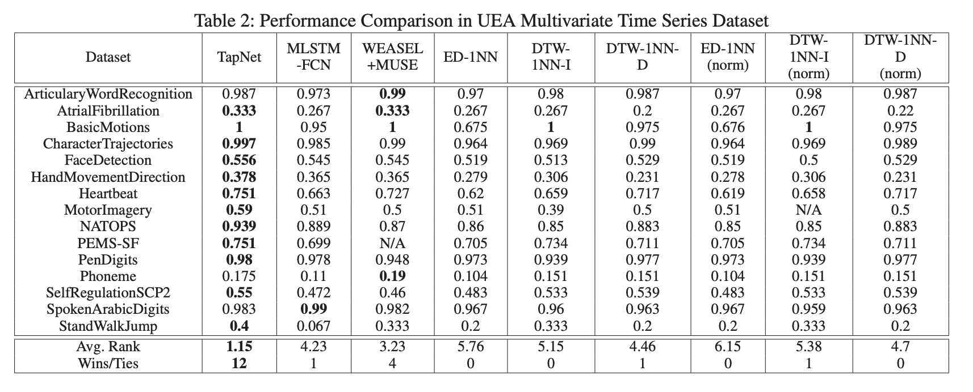
Experimental Setting
Dataset characteristics
Evaluated on 18 real world datasets
Dimensions range: 2 - 963
Time series length range: 8 - 3,000
Sample size range: 27 - 10,992

Slide 12
Experimental Setting
Metrics
Prediction accuracy
Avg.Rank
Number of win/ties
Benchmarks
WEASEL-MUSE
MLSTM-FCN
1NN-ED and 1NN-ED(norm)
1NN-DTW-i and 1NN-DTW-i(norm)
1NN-DTW-D and 1NN-DTW-D(norm)

Slide 13
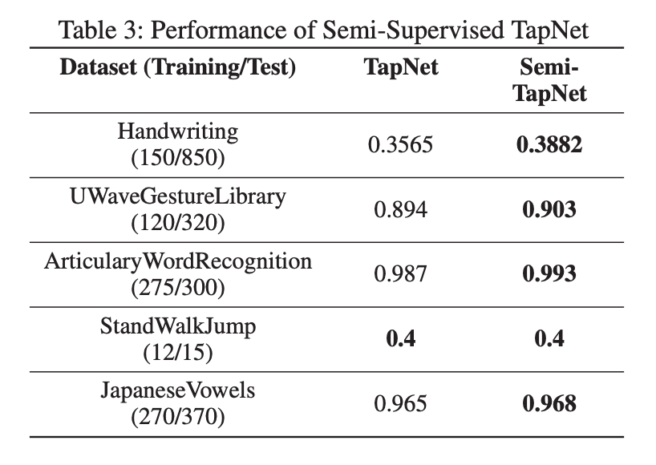
Results
Supervised TapNet
Semi-supervised TapNet

Slide 14
Conclusions
Achieves state-of-the-art performance in a wide variety of datasets
Able to combine the benefits of both traditional and deep learning methods and utilize unlabeled data
Has open source github repository
https://github.com/xuczhang/tapnet

